Slide 1

Dashboard for AI Legal Redaction Assistant

Slide 2

Contents
1. Define the Database Schema to store PII information
2. The Dashboard for AI Legal Redaction from CSV
3. The Dashboard for AI Legal Redaction with Streamlit
4. The Dashboard for AI Legal Redaction from sqlite3

Slide 3

1. Define the Database Schema to store PII information
# Sample Data (in pii_masked_data.csv):
# record_number,filename,pii_type,pii_value,masked,date
# 1001,hr_records.csv,Email,john.doe@example.com,1,4/10/2025
# 1002,finance_2023.xlsx,SSN,123-45-6789,1,4/7/2025
# 1003,logs.txt,Phone,555-123-4567,1,4/6/2025
# 1004,hr_records.csv,Email,jane.doe@example.com,1,4/8/2025
# 1005,hr_record1.pdf, name, Mike,0,4/8/2025
# 1006,hr_record1.pdf, address, 405 Hilgard Avenue Los Angeles CA 90095,0,4/8/2025
# 1007, hr_record1.pdf,signature,picture1,1,4/8/2025

Slide 4
2. The Dashboard for AI Legal Redaction from CSV

Slide 5
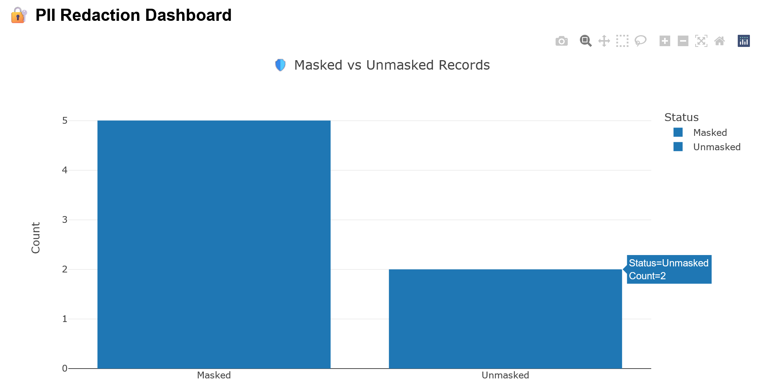

Slide 6
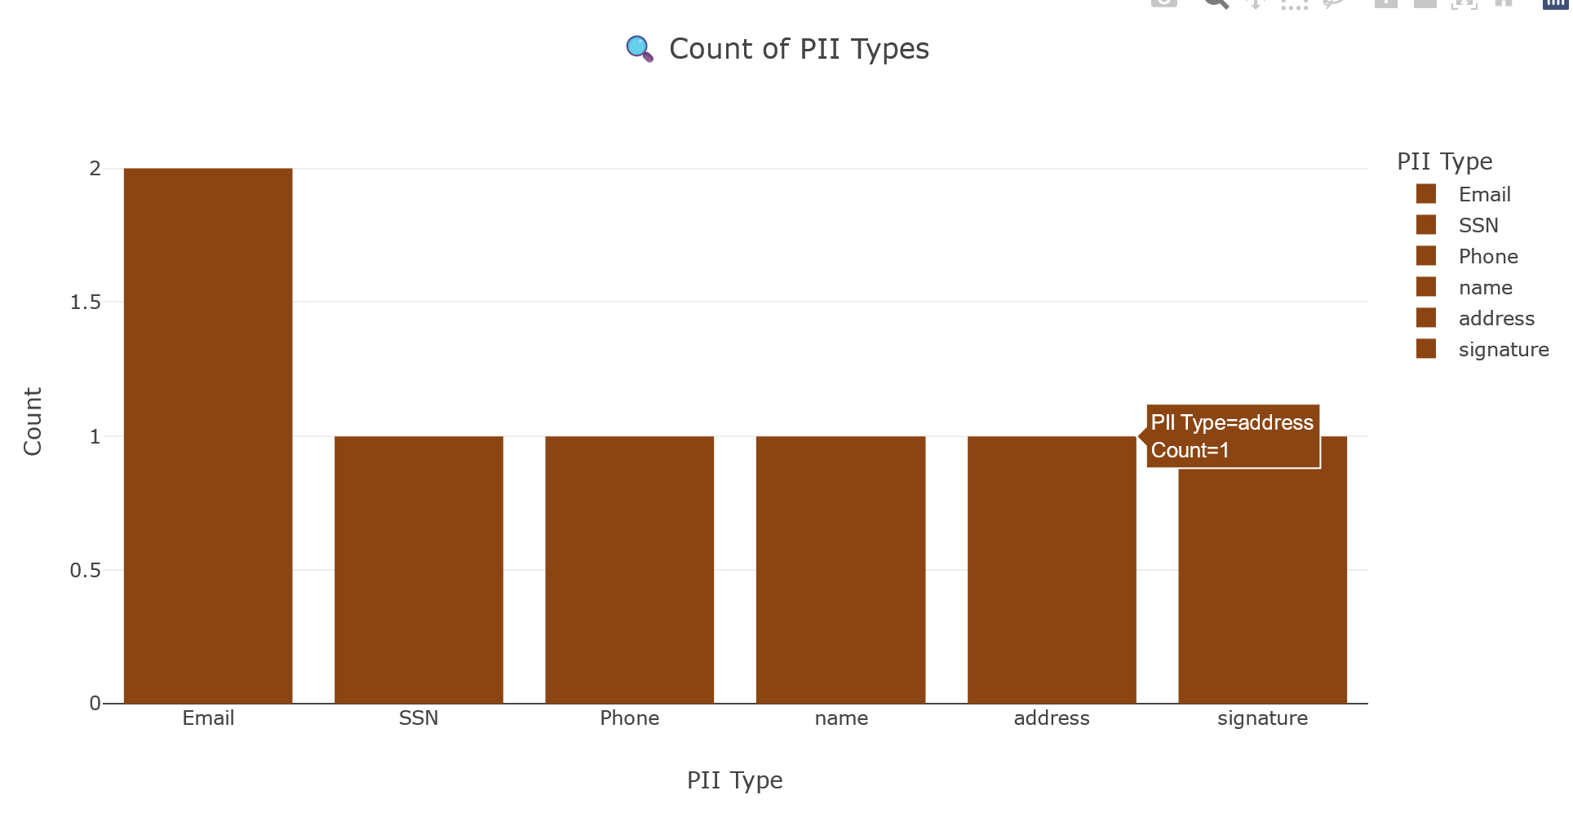

Slide 7
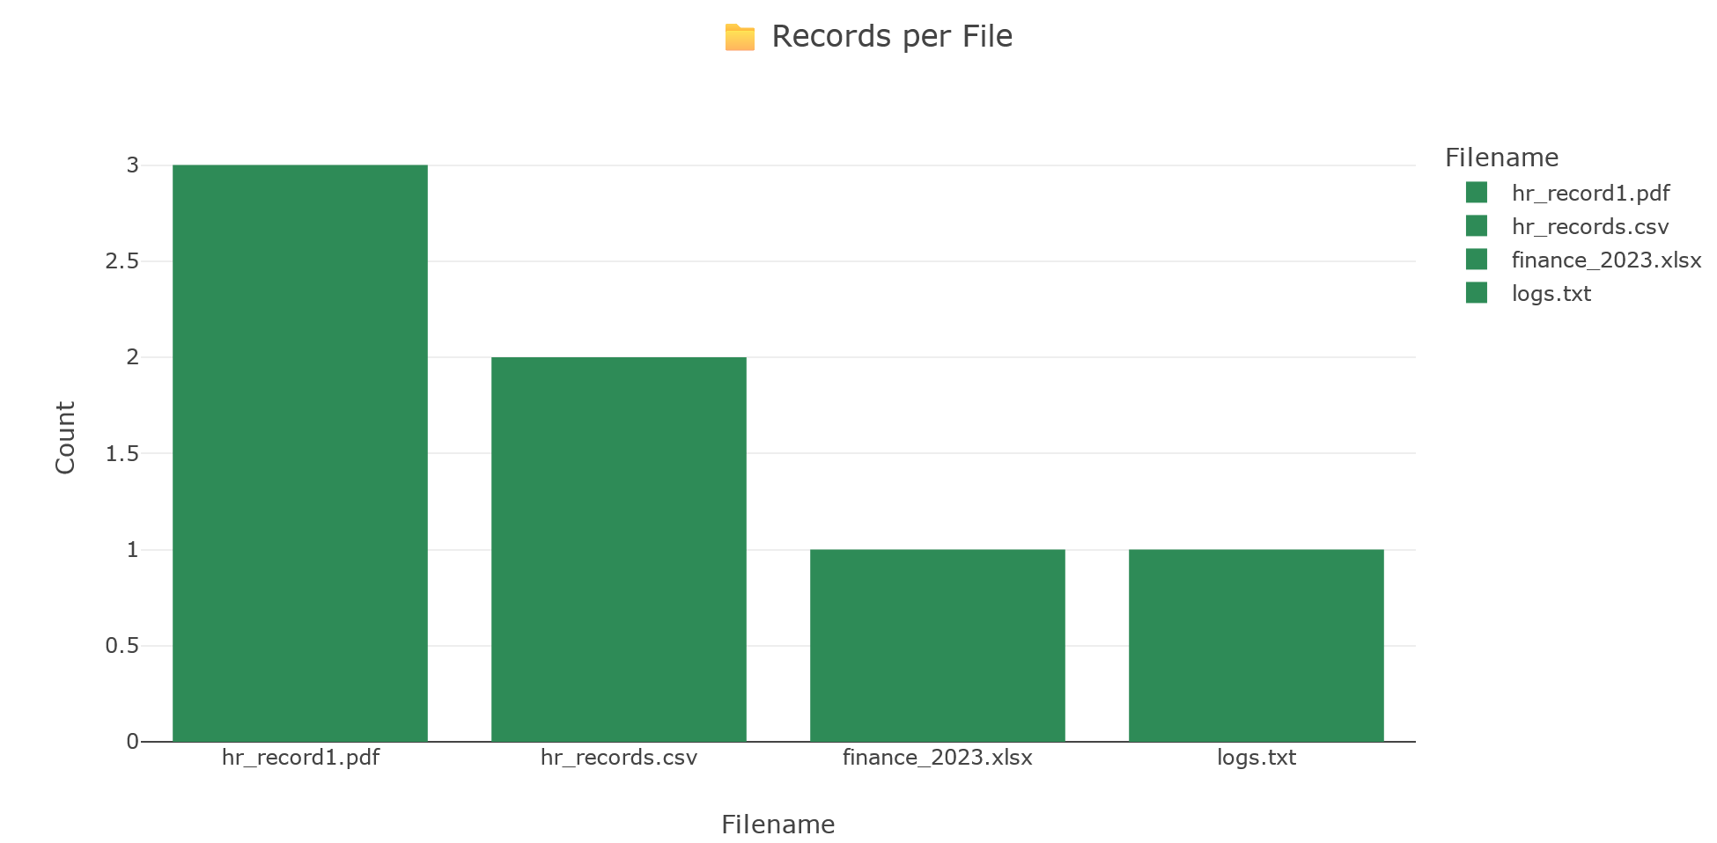

Slide 8
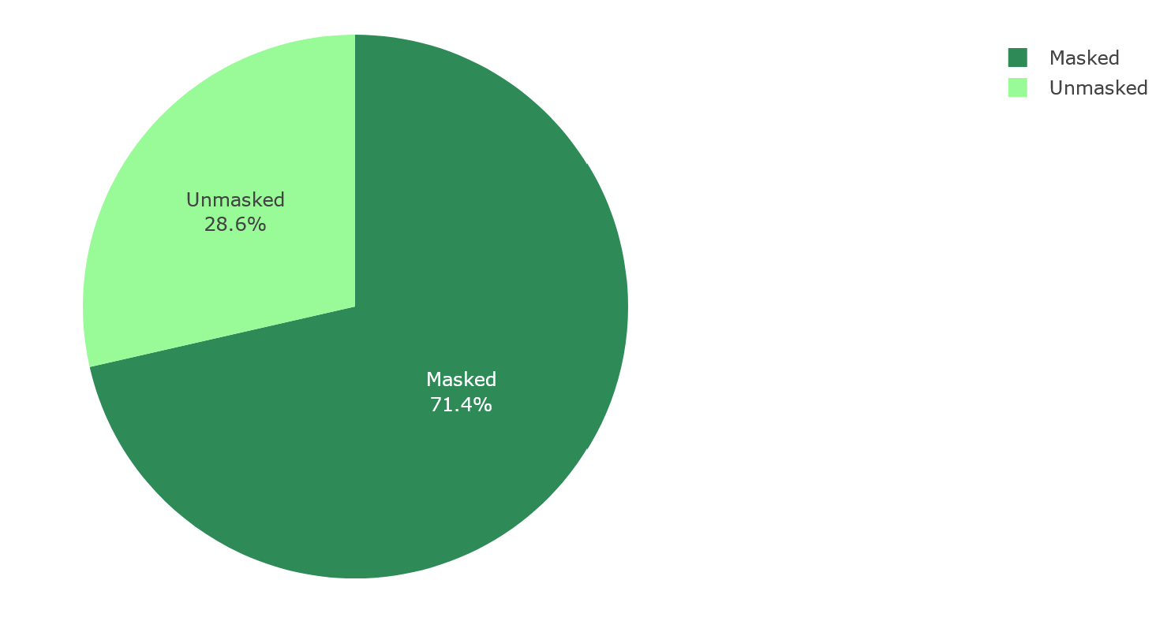

Slide 9
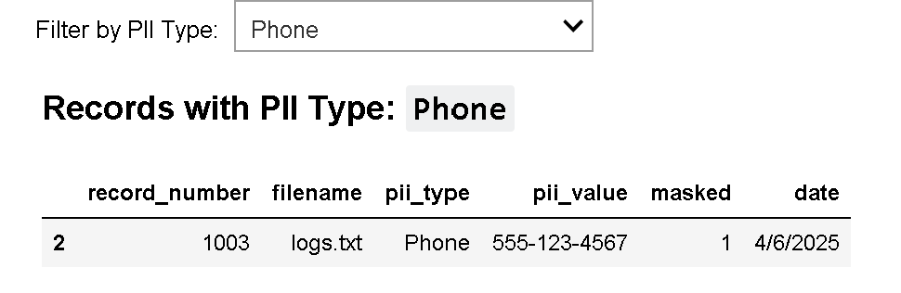
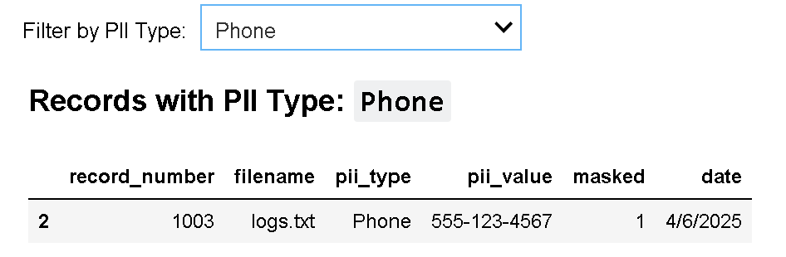
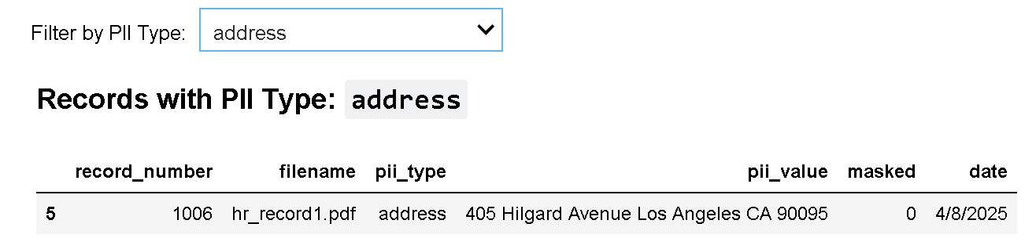

Slide 10
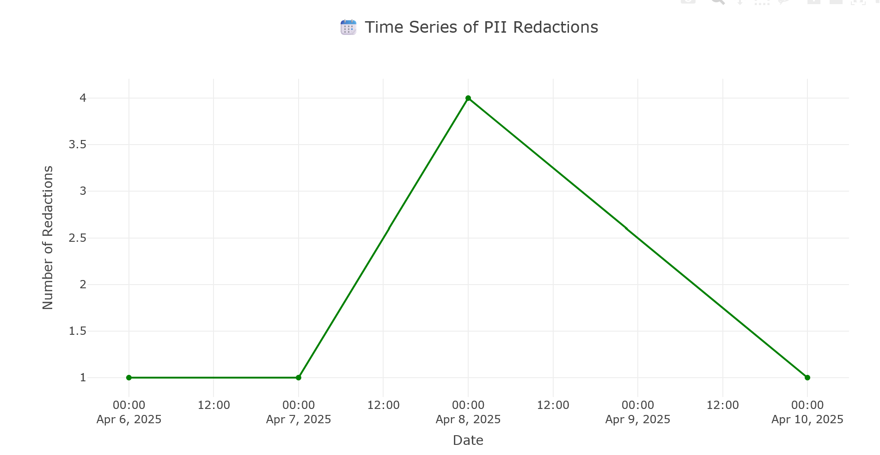

Slide 11
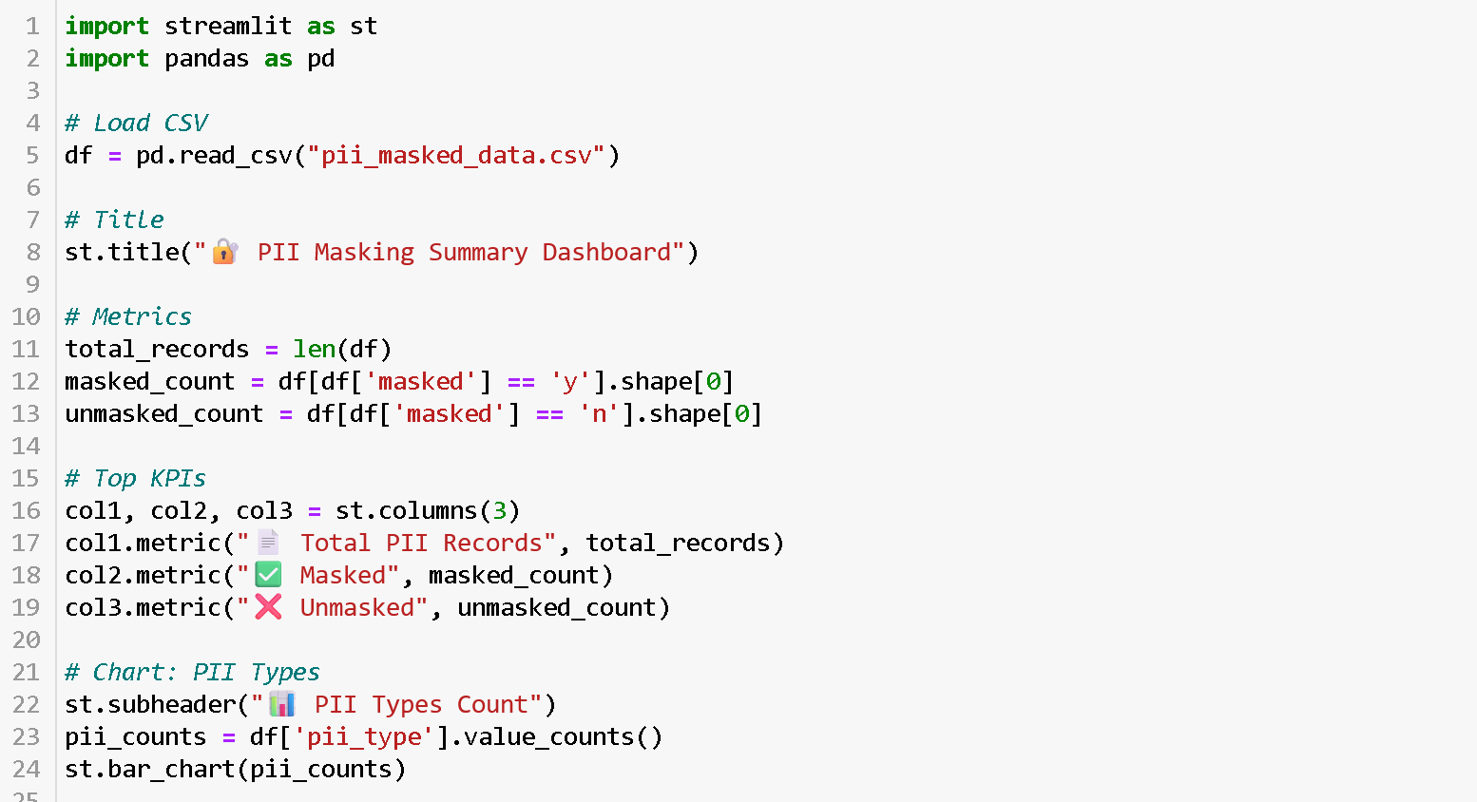
3. The Dashboard for AI Legal Redaction with Streamlit

Slide 12
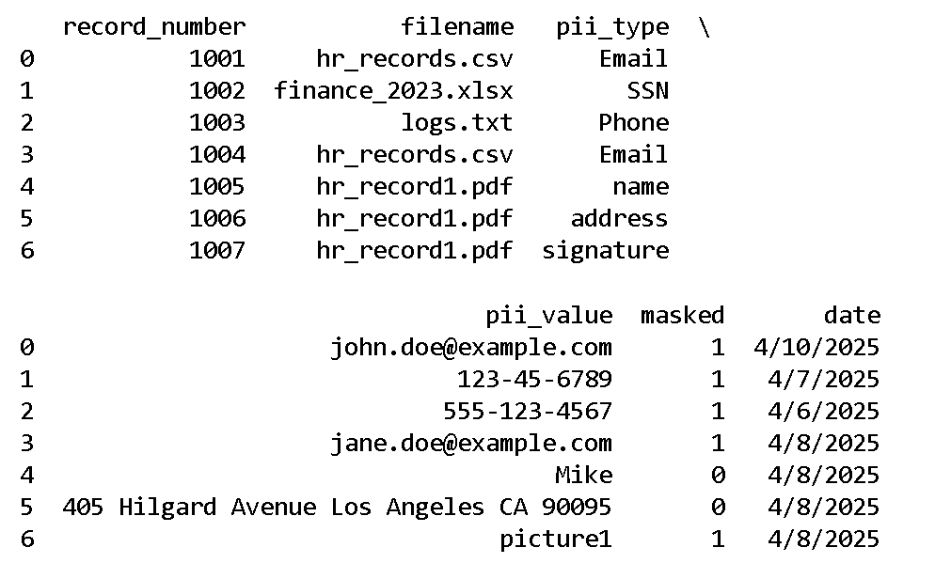
4. The Dashboard for AI Legal Redaction from sqlite3

Slide 13

Thank you for watching

